Slide 1
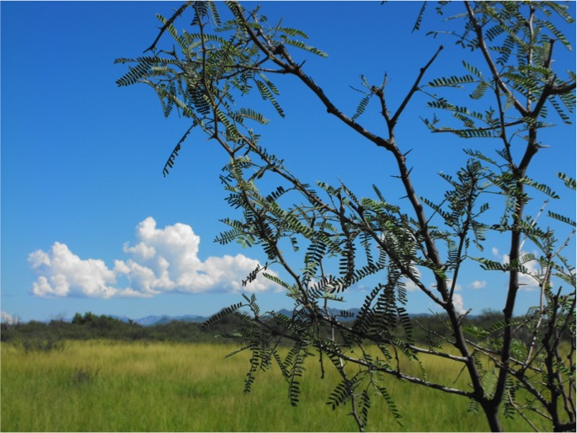




Agrivoltaics’ significance and applications in dryland agriculture and environments:
A climate-resilient system for maximizing food, energy, and water benefits
Greg Barron-Gafford

Slide 2
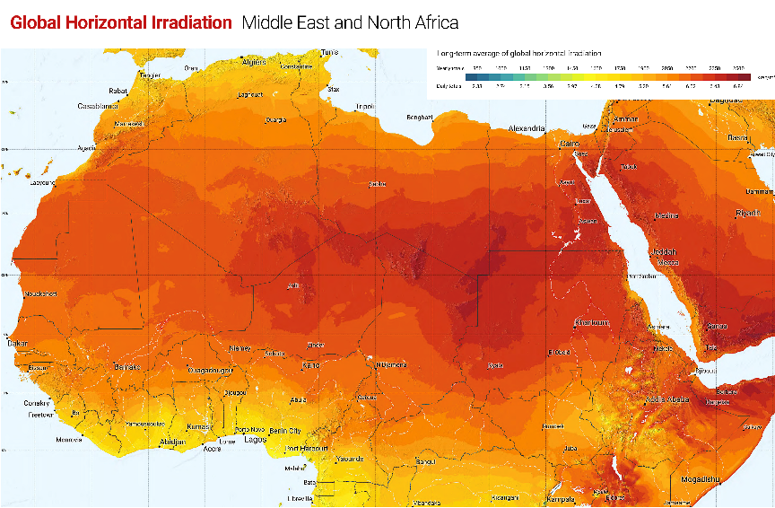
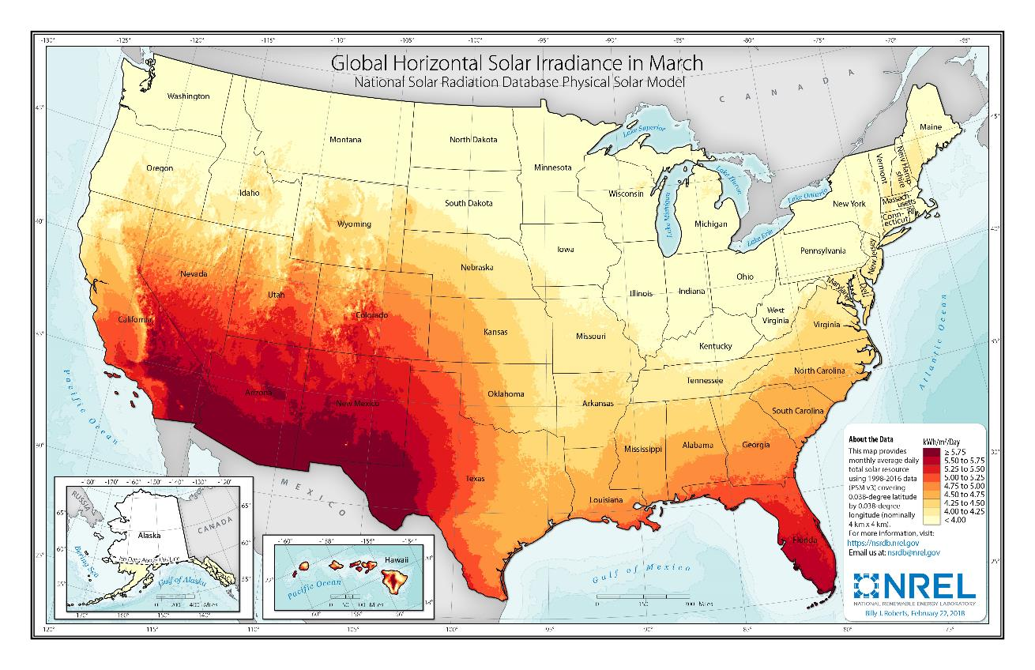
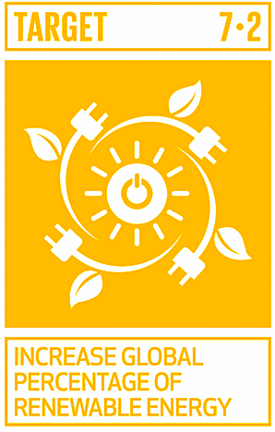
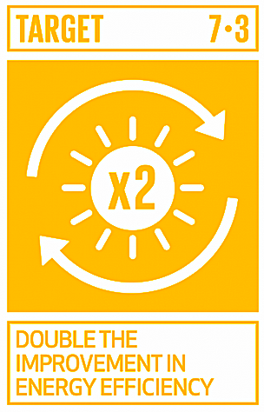


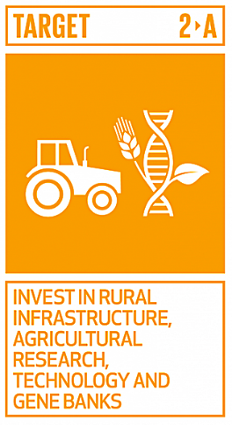
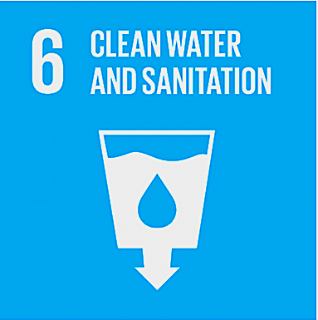
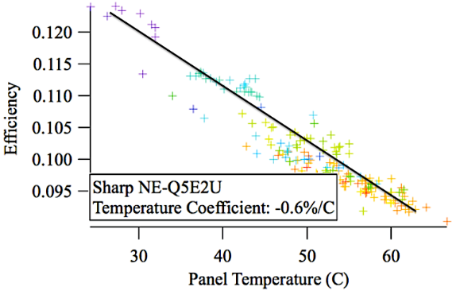
We want increase renewables, but those may also be vulnerable

Slide 3
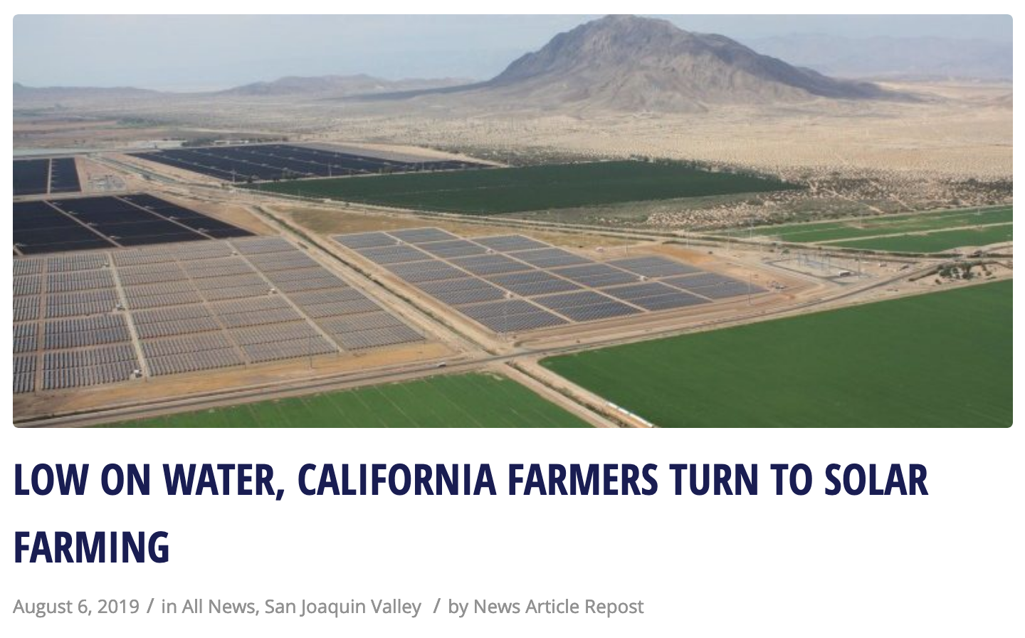
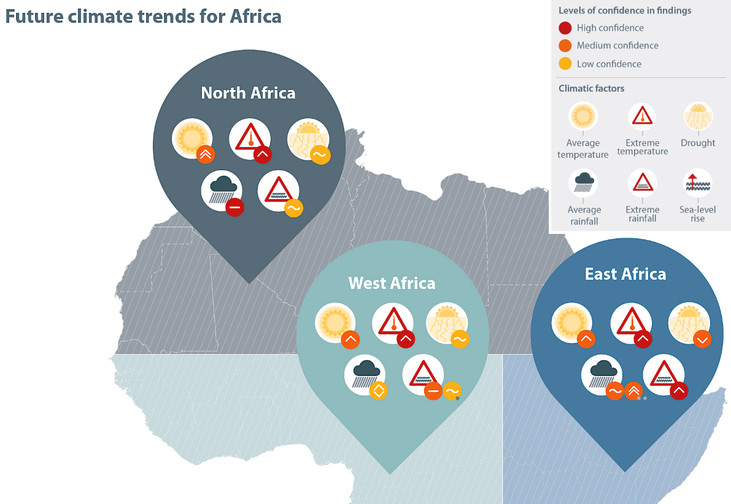
The climate is also changing…
Notes:
By some estimates, nearly half of recently proposed energy projects have been delayed or abandoned due to local concerns – representing a significant barrier to adoption (Pociask & Fuhr, 2011).

Slide 4
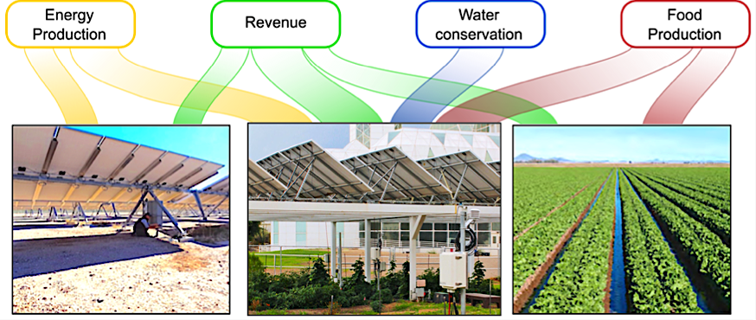
Co-locating vegetation + renewable energy could = food, energy, and water benefits
We need to move past an “either-or” in terms of our land allocation to generate many important ecosystem services

Slide 5
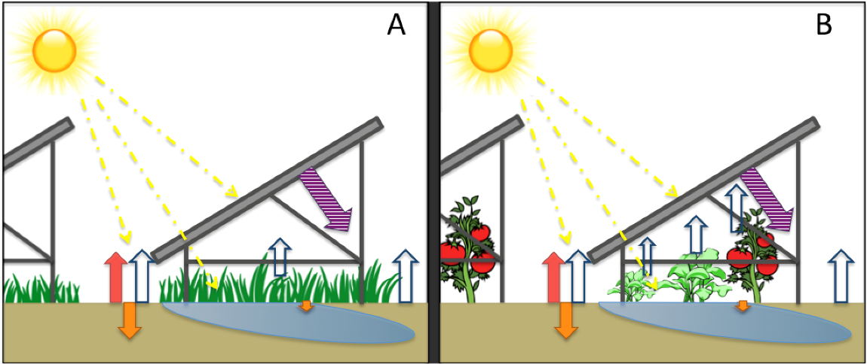
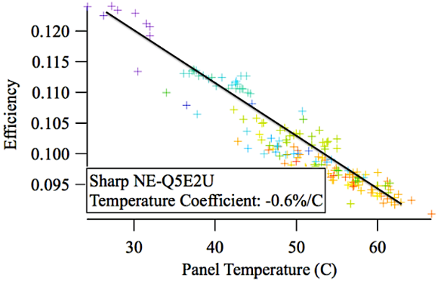
Co-locating agriculture + renewable energy could = food, energy, and water benefits
Create ‘agrisolar’ systems to:
1. Adapt food systems to survive drought and temperature stress
2. Improve renewable energy production through transpiration
3. Ease our dependence on irrigation

Slide 6
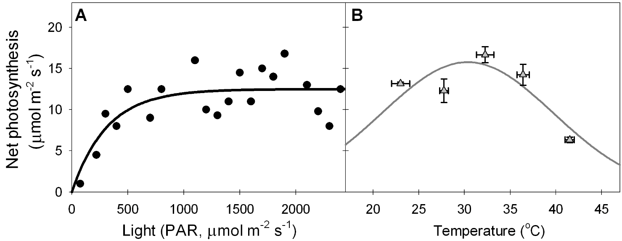
Can plants handle being grown in the shade?
A small reduction in photosynthetic capacity due to reduced light might be offset by better temperatures!

Slide 7
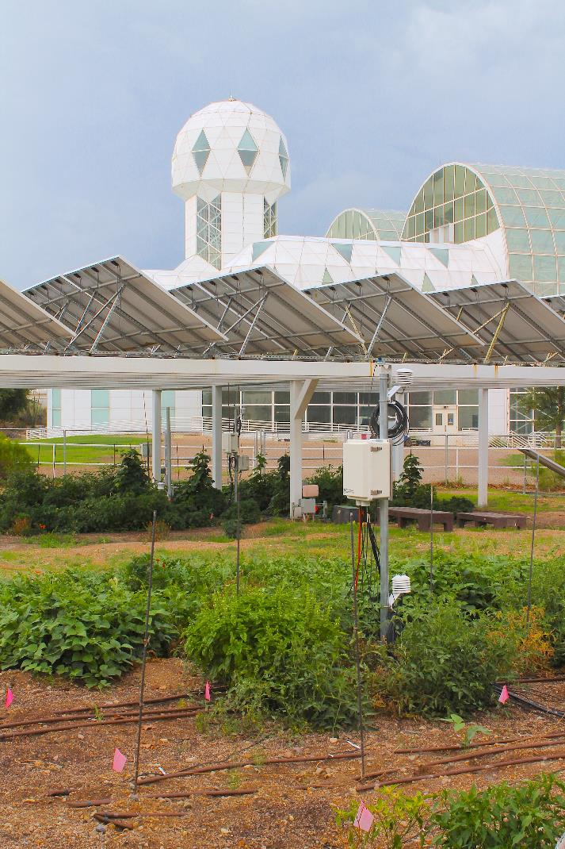
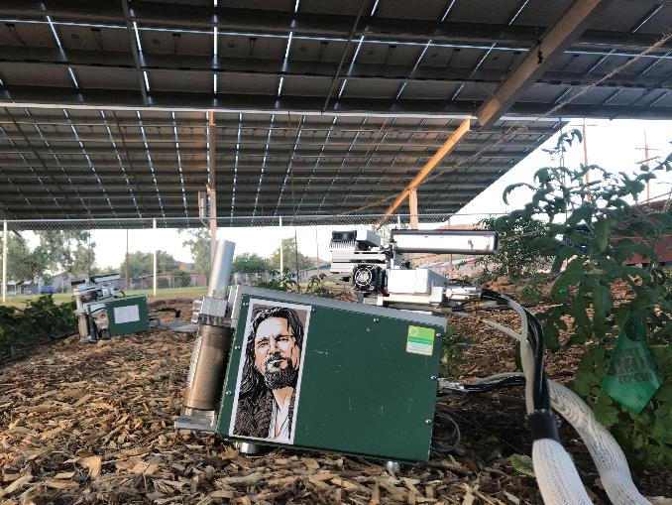
Biosphere 2 Agrivoltaics
Learning Lab
Notes:
Change photo; Moses runs with this!

Slide 8
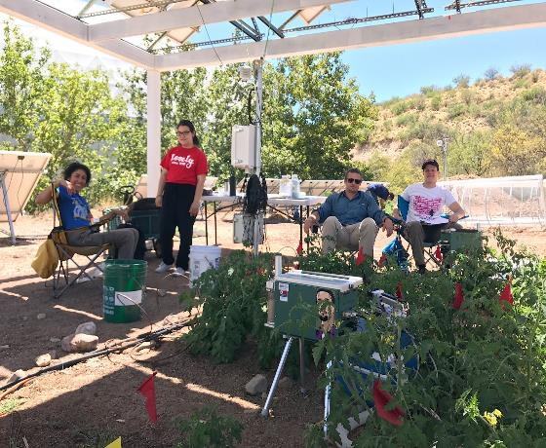
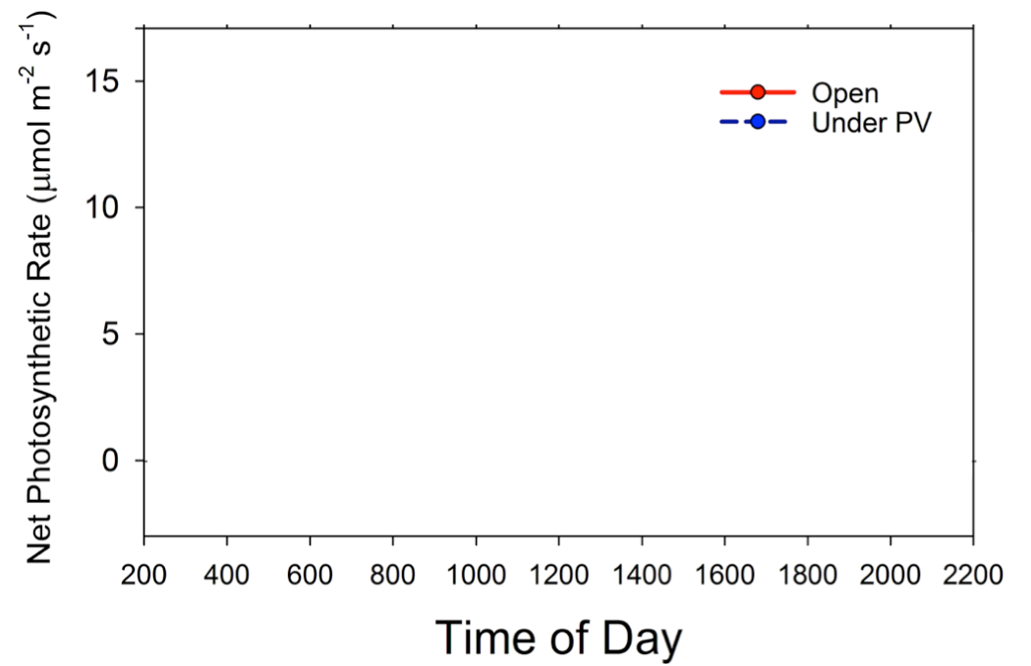
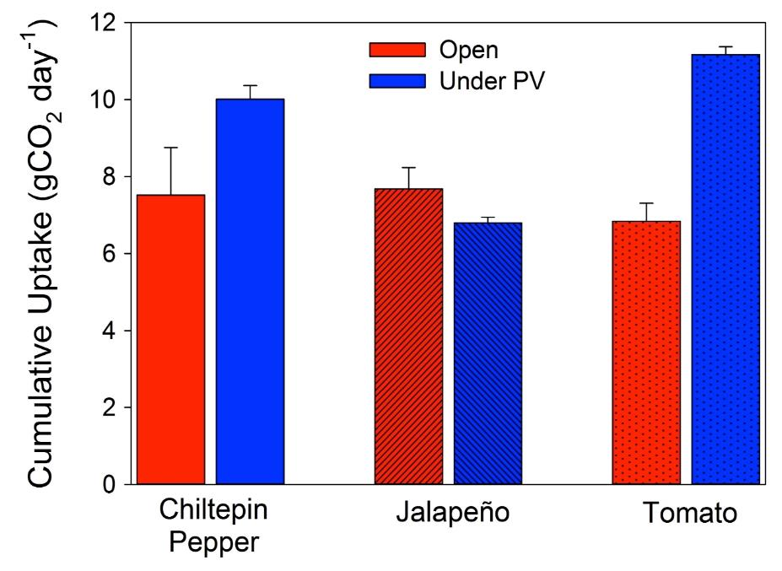
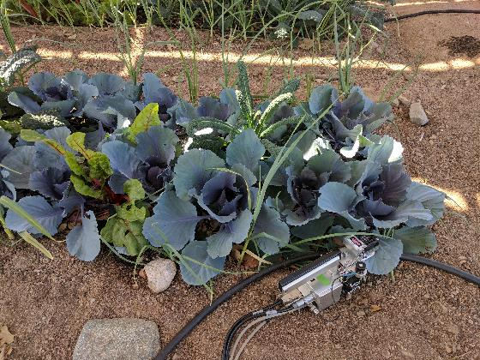
Food - a win for carbon uptake!
Barron-Gafford et al. (2019) Nature Sustainability

Slide 9
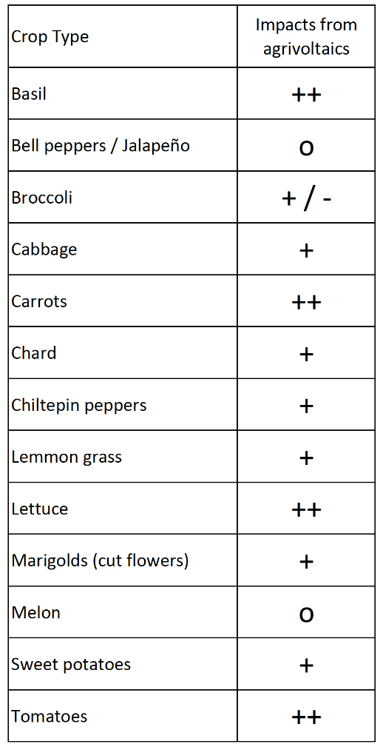
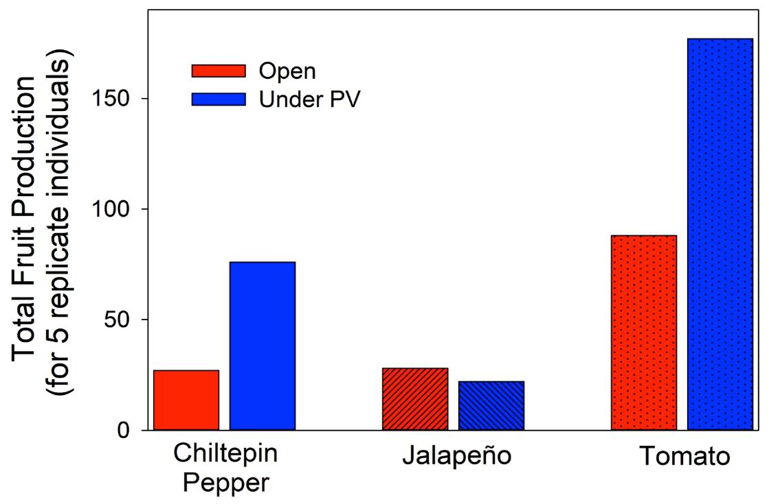
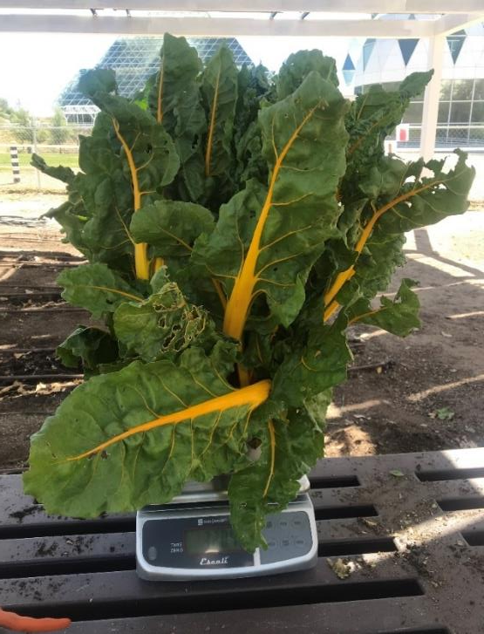
Food - a win for food production!
Barron-Gafford et al. (2019) Nature Sustainability

Slide 10
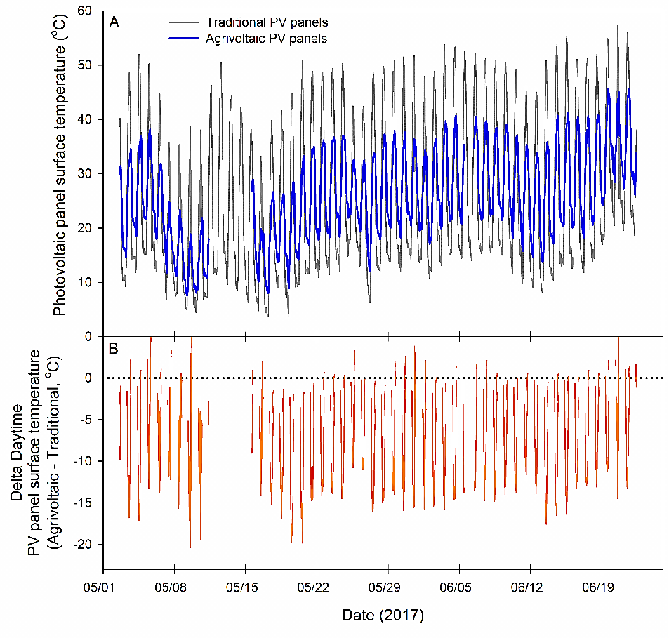
Energy - a win for PV production!
Cooler temperatures = Increased PV efficiency and less wear-and-tear
Summer time average cooling ~9ºC
Barron-Gafford et al. (In revision) Nature Sustainability

Slide 11
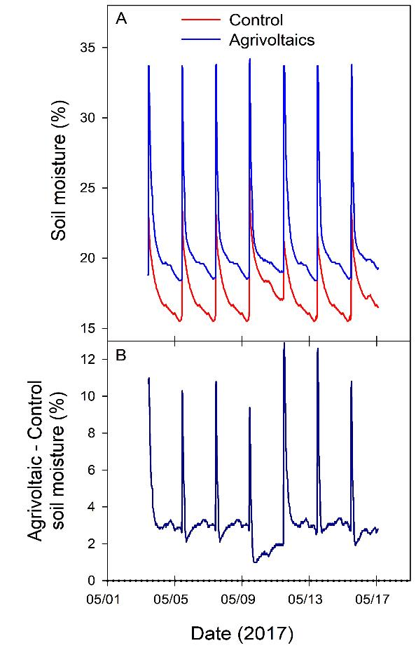
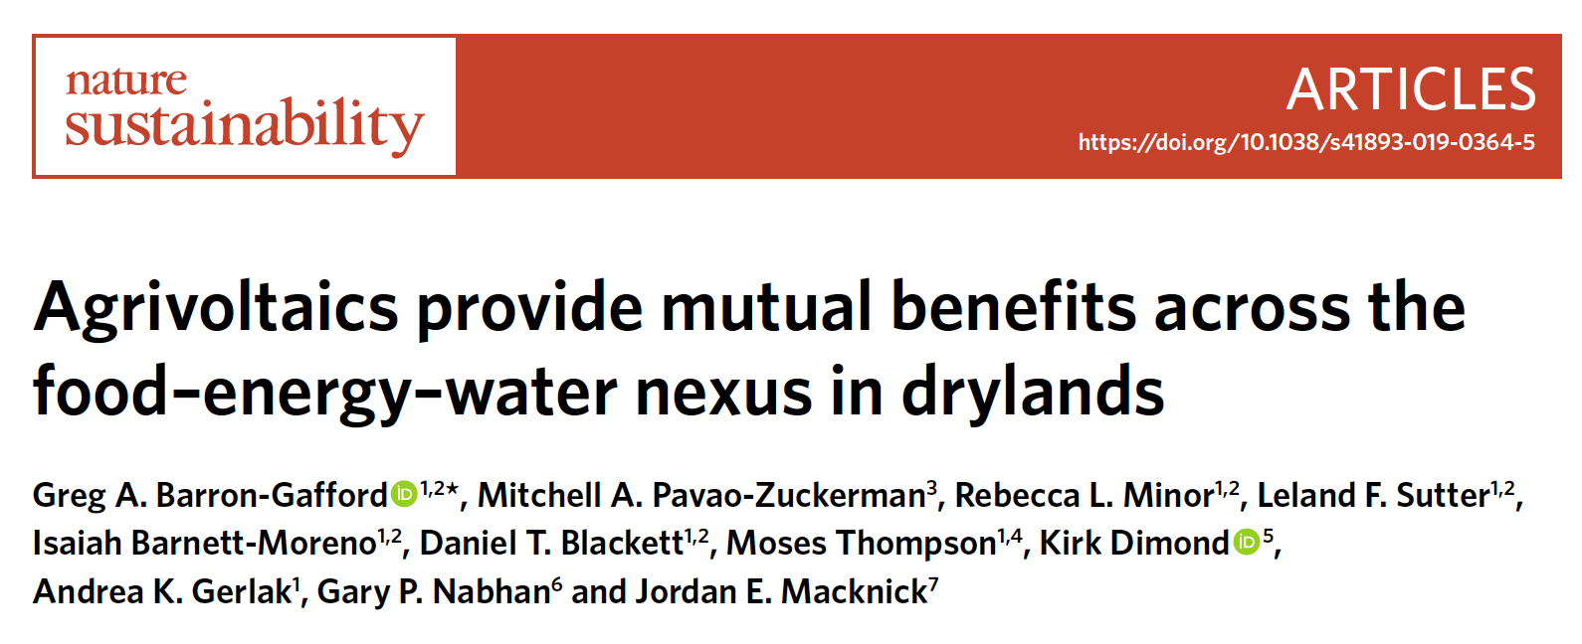
Water - a win for irrigation savings!
Microclimate change under the panels = water lasts longer in the soil
Soil moisture levels in agrivoltaic system after 2 days = control setting after about 2-3 hours
Can marginal lands now become arable lands?
Can we actually reduce our irrigation water use?
Barron-Gafford et al. (In revision) Nature Sustainability

Slide 12
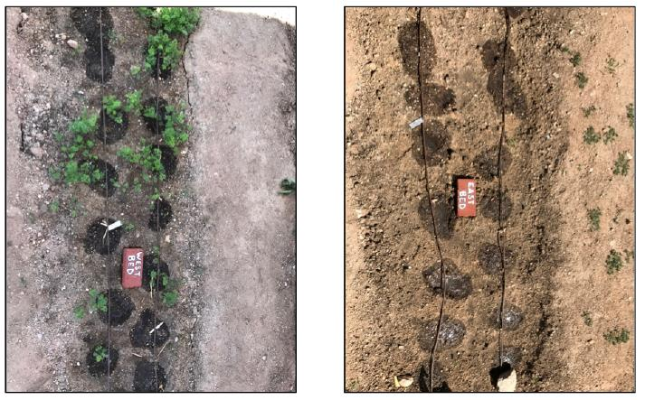
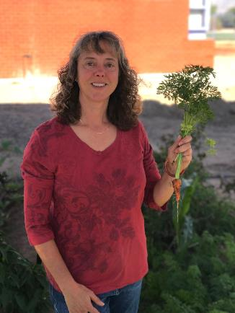
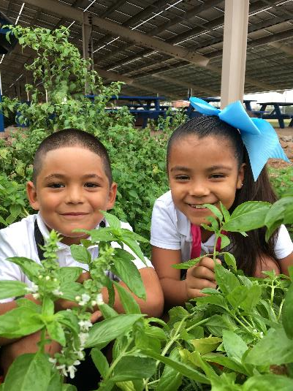
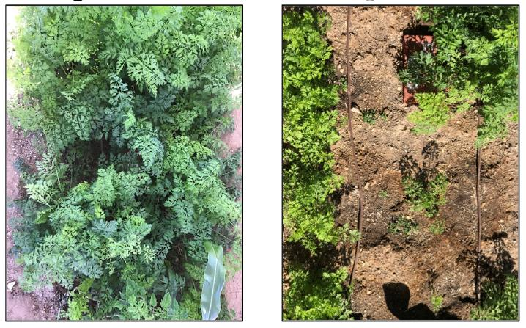
Other interesting findings …
* Extending the growing season
(changing the phenology)
Agrivoltaics
Open-sun
Notes:
Moses runs with this!

Slide 13
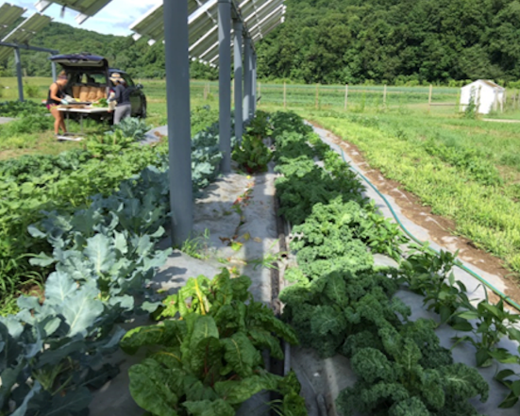


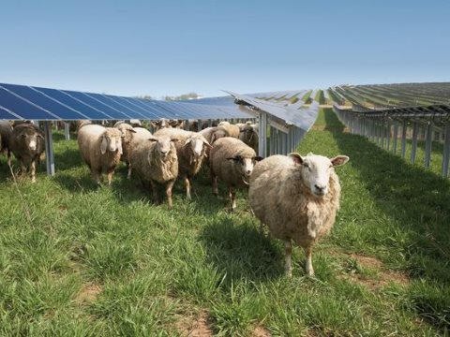
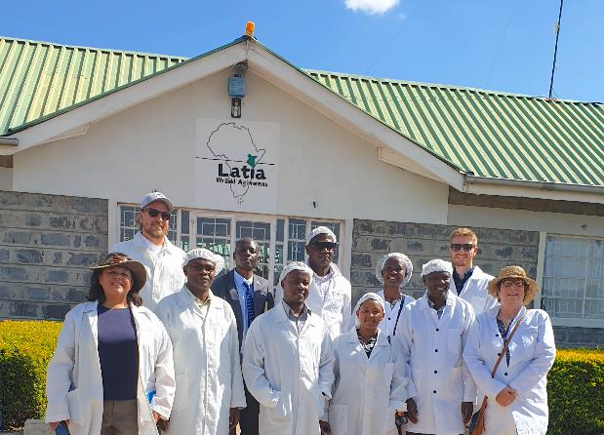
Examining wider adoption…
Exploring application across environmental gradients in the US…
Jordan Macknick
PV + grazing
… and East Africa
Notes:
Change photo; Moses runs with this!

Slide 14

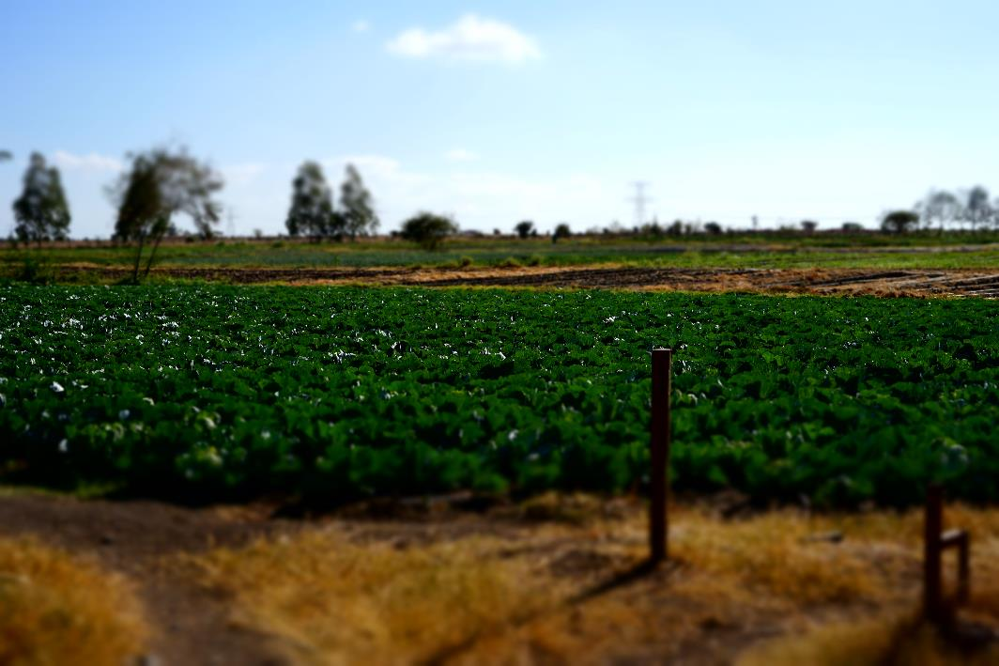



Agrivoltaics in East Africa:
Harvesting the sun twice: could agrivoltaics enhance energy and food security in East Africa?
Contact: Richard Randle-Boggis:
r.randle-boggis@sheffield.ac.uk
Notes:
Change photo; Moses runs with this!

Slide 15
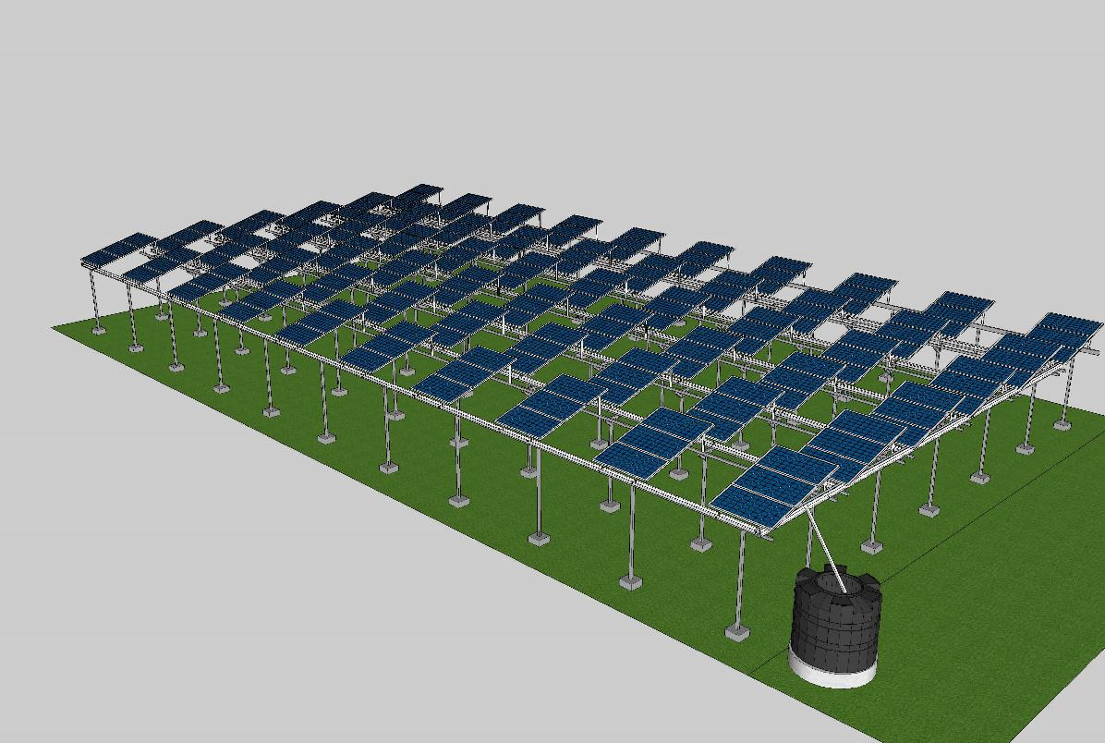
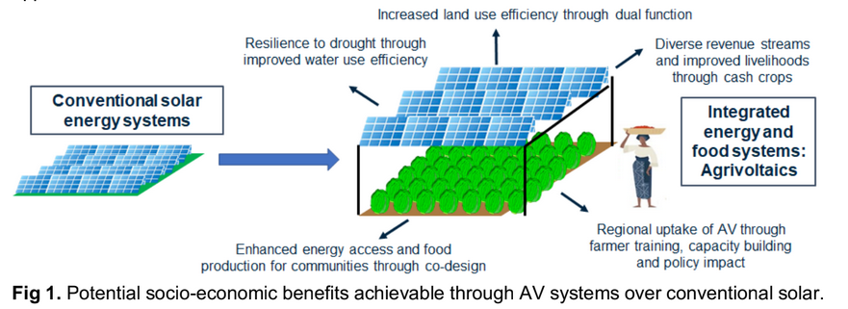
Agrivoltaics in East Africa:
Harvesting the sun twice: could agrivoltaics enhance energy and food security in East Africa?
Contact: Richard Randle-Boggis:
r.randle-boggis@sheffield.ac.uk
Notes:
Change photo; Moses runs with this!

Slide 16
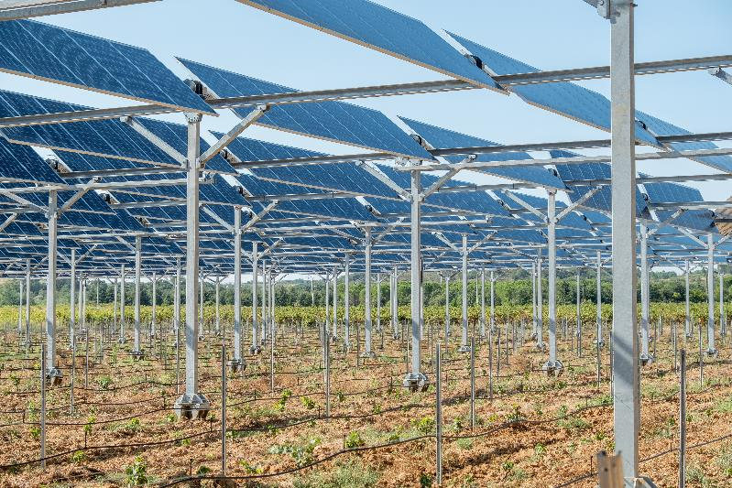

Important consideration: Cost/benefit analysis
Land use efficiency can be optimized nearly anywhere, so we need to think about this in terms of maximizing cumulate “services” and increasing sustainability and resilience to changing climate.
Total Costs:
+ Extra steel
- Leasing “understory”
Food / forage production
Water savings
Opposition / Zoning
Notes:
Change photo; Moses runs with this!

Slide 17
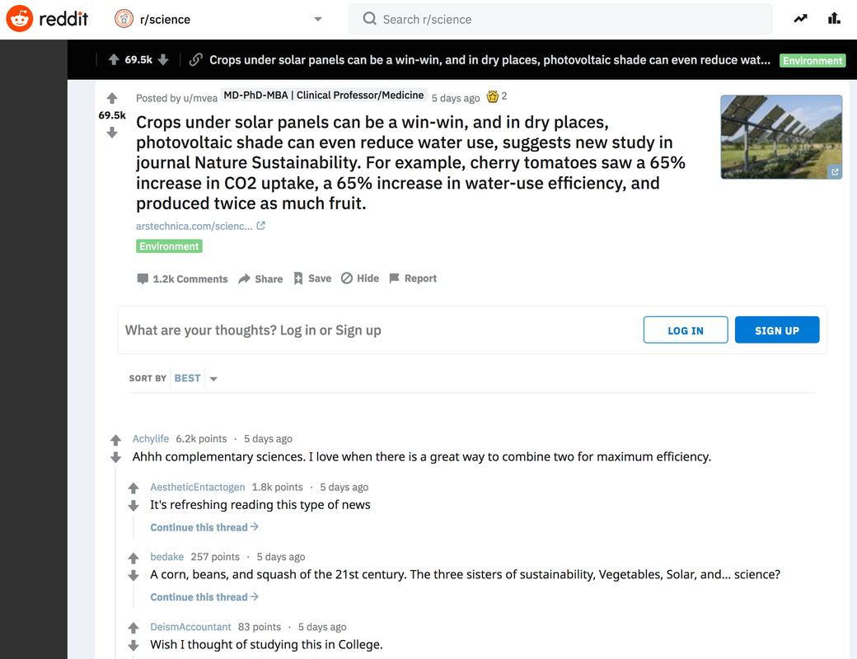
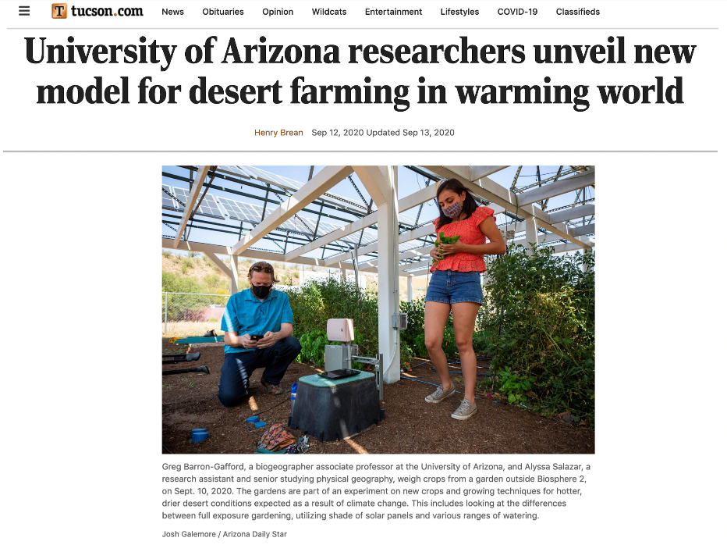
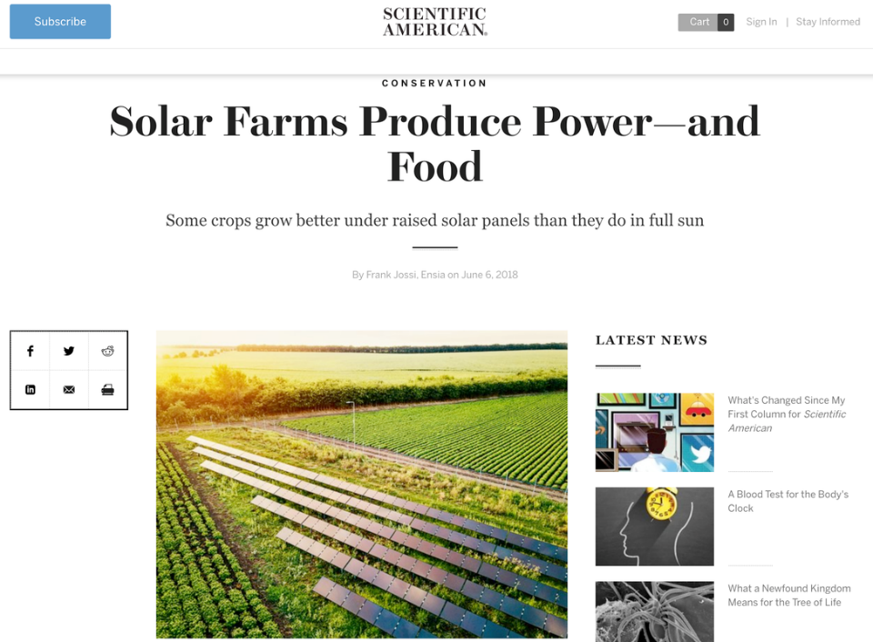
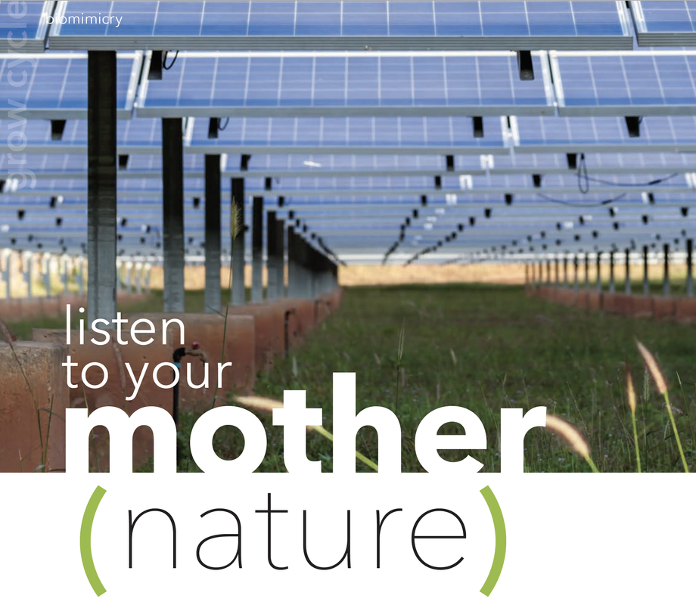
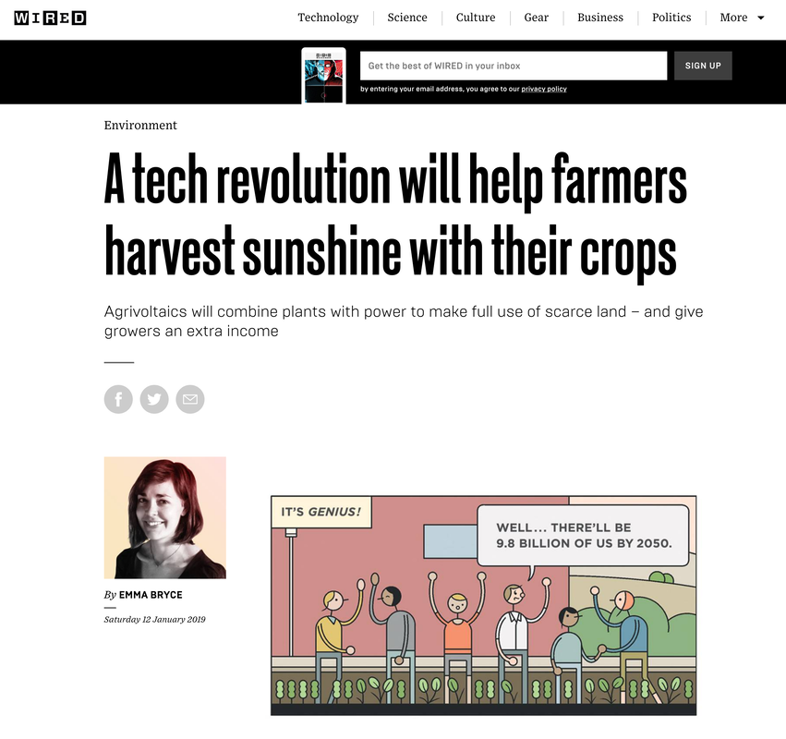
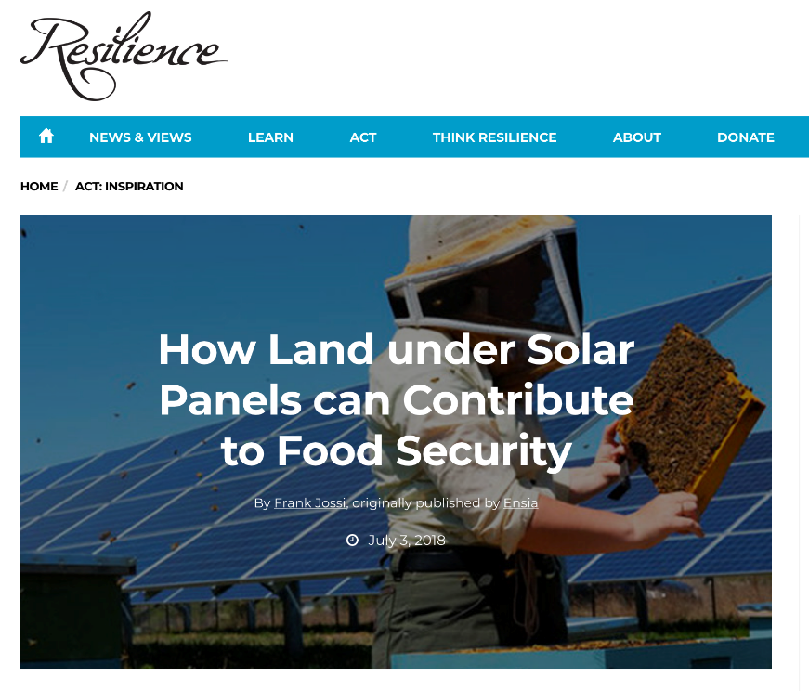
The public is ready for a solution!

Slide 18
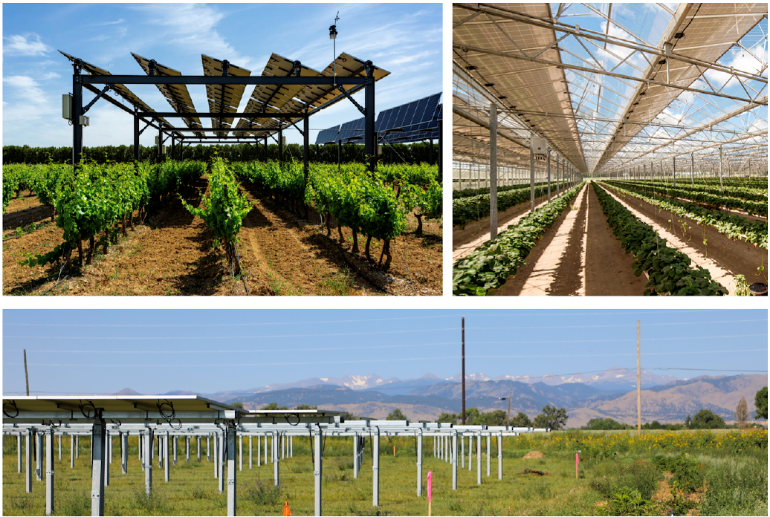
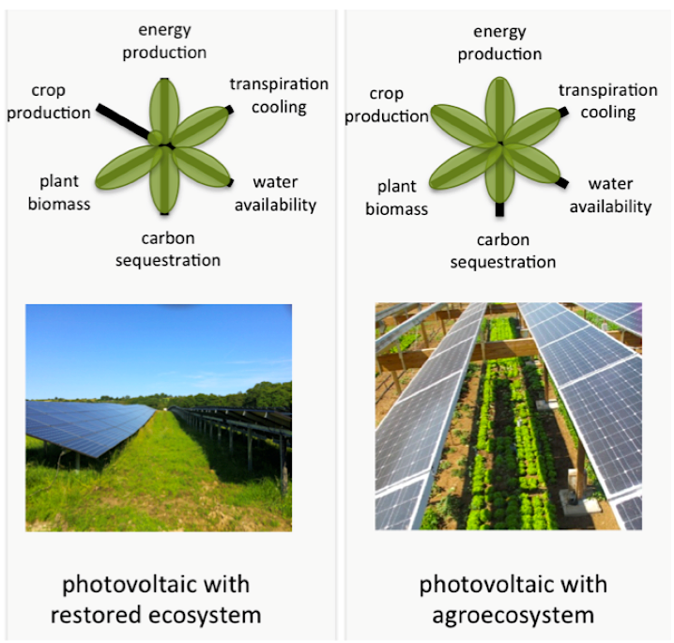

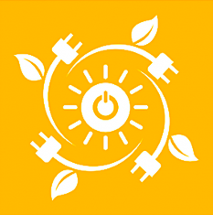
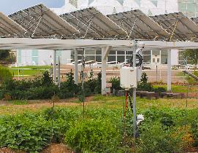
…so what do we need to develop that solution?
Develop common metrics across space and time
Learn needs from PV and farms simultaneously
Assess potential for agrivoltaics approach across the globe!
Enumerate the costs and benefits associated with agrivoltaics system
Notes:
evaluating practices to date, and conducting research and analysis that enable farmers, ranchers, and other agricultural enterprises to gain value from solar technologies while maintaining availability of land for agricultural purposes.

Slide 19


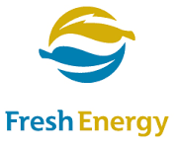









To learn more, please visit: www.barrongafford.org/agrivoltaics

Slide 20
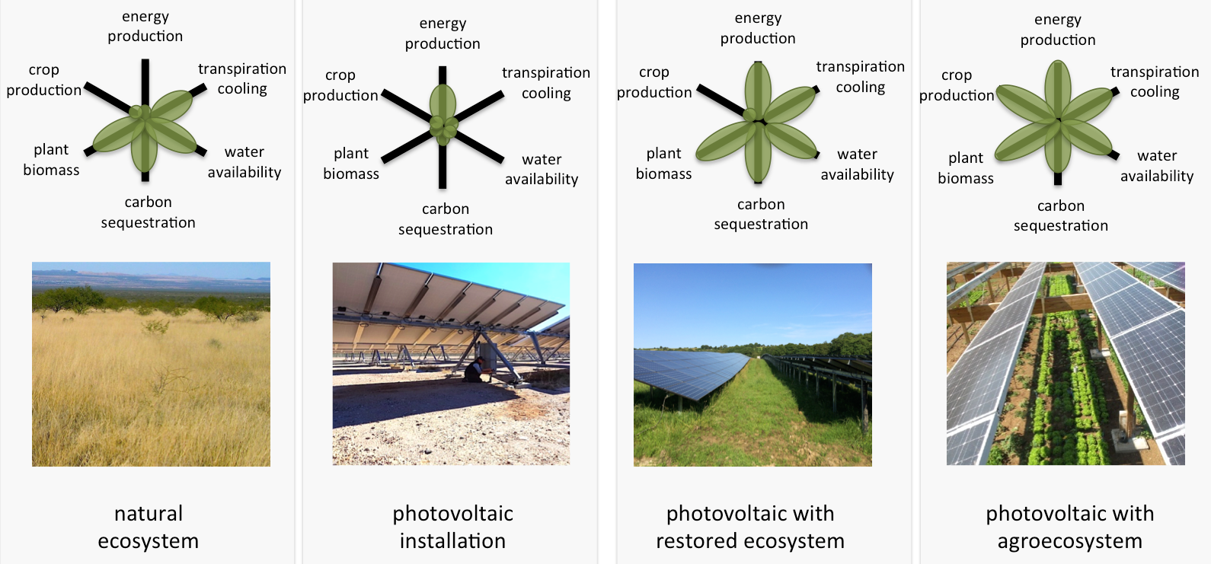
Cost/benefit analysis
Getting past an “either-or” in terms of our land allocation can open us to many important ecosystem services

